Slide 1

PHP and MySQL
SWE 322 - Advanced Web Development
Software Engineering Department
College of Engineering and Architecture
Al Yamamah University
Getting Them To Talk
Instructor: Layla Albabtain Fall 2020

Slide 2
Goal
Connect to Database.
Insert the input into the database.

Slide 3
PHP and MySQL
An overview of software available for using MySQL from PHP can be found at Overview
Documentation for MySQL can be found at http://dev.mysql.com/doc/.

Slide 4
PHP and MySQL
To interact with MySQL database, we will use: mysqli extension.
To interact with the database we need the following information:
Database server ip.
Username.
Password.
Database name.
Where can we get them?

Slide 5
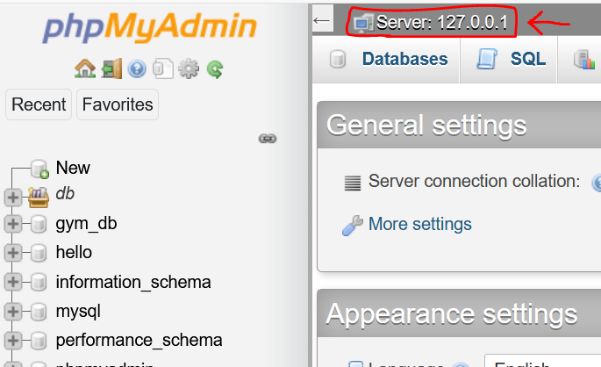
Database Server IP
If we are connecting with a database on a different machine/server, we will need the IP of the machine.
If the webpage is on the same machine as the database, the connection will be local.
You can get the IP from phpMyAdmin page.

Slide 6
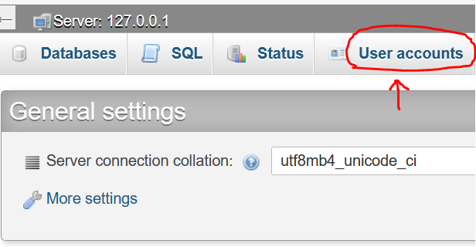
Username
The database, like anything else has users and each user has a password.
There are a list of default users with no passwords.
Is it wise to leave them with no passwords? Why?
For now, lets use root.
The password is null.

Slide 7
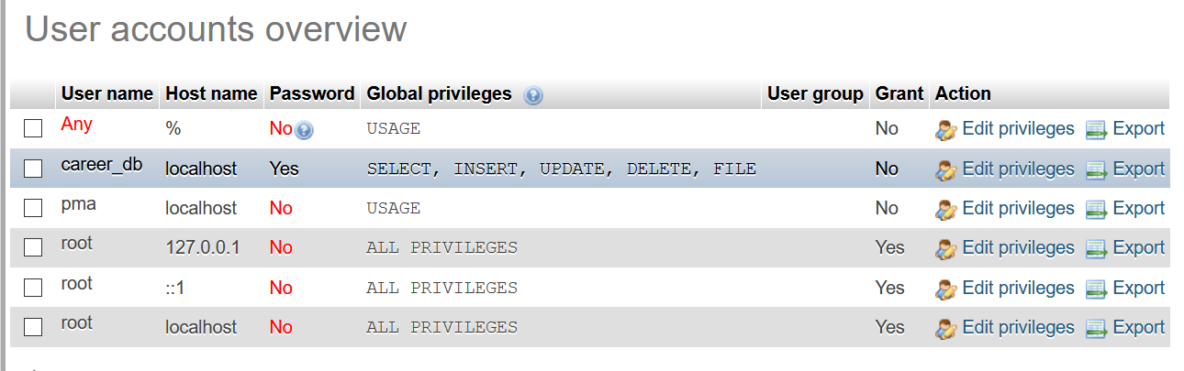
Username

Slide 8
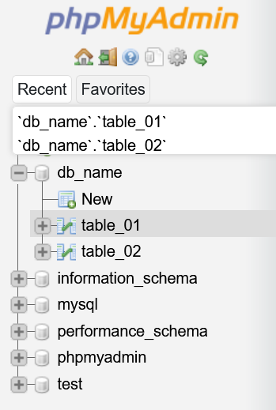
Database Name
A database server can host many databases.
Each database has many tables.
When we connect to a server, we need to tell the page which database we will interact with.
In our case the database name is: db_name.
The name is the one we chose to use.

Slide 9
What Now?
We have the required information:
Host_IP = "172.0.0.1".
username = "root". //or the user we have created
password = "". // root currently has no password and this is wrong!
database = “db_name".
How to connect?
Let’s check mysqli. There is mysqli_connect
This function is an alias of: mysqli_construct()
Syntax: mysqli_connect(Host_IP, username, password, database);
Let’s replace the parameters with values:
$conn = mysqli_connect("172.0.0.1", "root", "", “db_name");

Slide 10
What now?
We would like to make sure there are no connection problems and if there was, we need to know what is the problem. Therefore, we will the following:
if(!$conn){
echo "Debugging errno: " . mysqli_connect_errno();
echo "<br>";
echo "Debugging error: " . mysqli_connect_error();
exit;
}

Slide 11
Connection Errors
If the connection hasn’t been made, we would like to print the error number and the error and exit the file.
If the connection has been made the code inside the if statement will be ignored.

Slide 12
What now?
Now the connection has been made.
We would like to insert data in the database.
How to insert data?.
We can do that in two ways in phpMyAdmin.
SQL
Use this query for table_01:
INSERT INTO `table_01`(`col_02`, `col_03`, `col_04`) VALUES ("1","test","test");
INSERT
Insert the data in the required fields.
Remember, there is no need to add anything in the PK as it is A_I.

Slide 13
Inserting Data using PHP
We will need to use SQL statement within PHP code.
The SQL statement can be excuseted using:
mysqli_query();
mysqli_query() takes two arguments:
The connection.
The query.
Syntax should be:
mysqli_query($conn, “INSERT INTO `table_01`(`col_02`, `col_03`, `col_04`) VALUES ("1","test","test");

Slide 14
Inserting Data using PHP
A check must be made to see if there were no error and the insertion has been successful.
mysqli_query() Returns true if the query has been successful and false if not.
This means it can be used for the check, as follows:
if (mysqli_query($conn, $query)) {
echo "Data has been successfully inserted";
} else {
echo "Error: ".$query."<br>".mysqli_error($conn);
}

Slide 15
What now?
After everything has been done, the connection with the database must be closed.
The connection can be closed using:
mysqli_close();
mysqli_close(), takes the connection as argument, here is an an example:
mysqli_close($conn);

Slide 16
Web Page
<!DOCTYPE html>
<html lang="en">
<head>
<meta charset = "UTF-8">
<title> Data Retrieval </title>
</head>
<body>

Slide 17
<?php
$host_ip = "127.0.0.1";
$username = "root"; //or the user we have created
$password = "";//root currently has no password and this is wrong
$database = "db_name";
$conn = mysqli_connect($host_ip, $username, $password, $database);

Slide 18
if(!$conn){
echo "Debugging errno: ".mysqli_connect_errno();
echo "<br>";
echo "Debugging error: ".mysqli_connect_error();
exit;
}
$query = "INSERT INTO `table_01`(`col_02`, `col_03`, `col_04`) VALUES ("1","test","test");
";

Slide 19
$query = "INSERT INTO `table_01`(`col_02`, `col_03`, `col_04`) VALUES ('1','test','test')";
if (mysqli_query($conn, $query)) {
echo "Data has been successfully inserted";
}else {
echo "Error: ".$query."<br>".mysqli_error($conn);
}
mysqli_close($conn);
?>
</body>
</html>

Slide 20
Practice
Create the same database in the MySQL slide.
db_name.
Use the code here and see if it insert values in the database.
Why inserting a previously inserted value in col_02 will generate an error?
If you have problems, discuss it with me during class.

Slide 21
Resources
Learning PHP & MySQL Book.

